Slide 1

Доклад на тему: “ИИ в сфере: спорта + Типы решаемых задач. Особенности”
Занина Мария, 301 группа

Slide 2
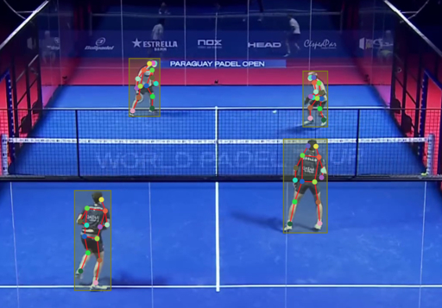
Содержание
Данные в спортивной сфере и как с ними работать
Постановки основных задач
Архитектуры моделей машинного обучения
Разбор статей: используемых моделей, метрик, результатов
Реальные продукты и их ограничения

Slide 3
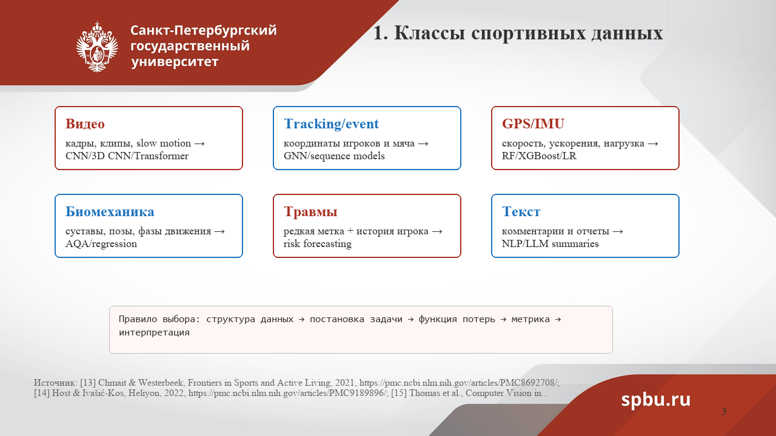

Slide 4
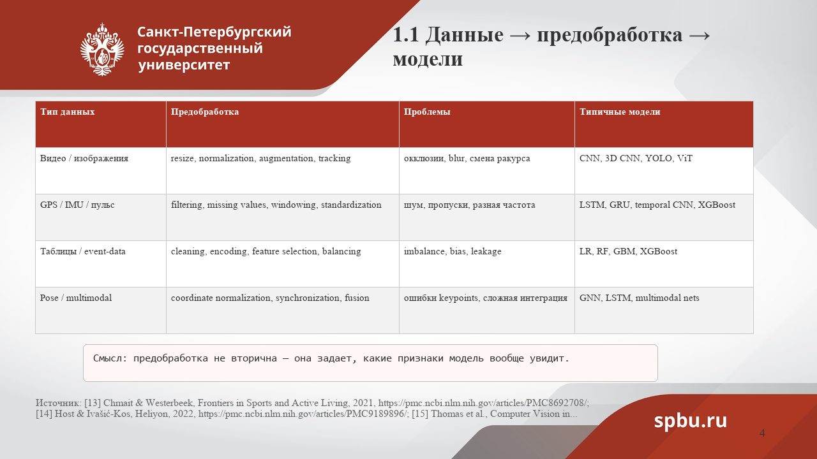

Slide 5
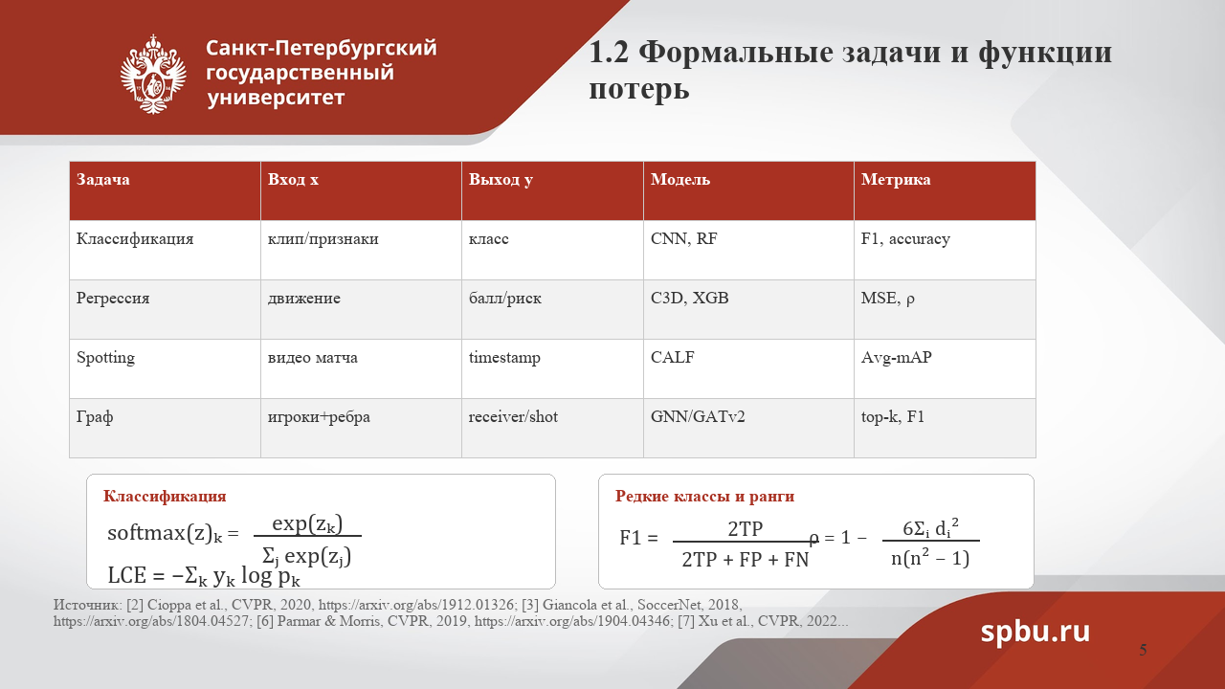
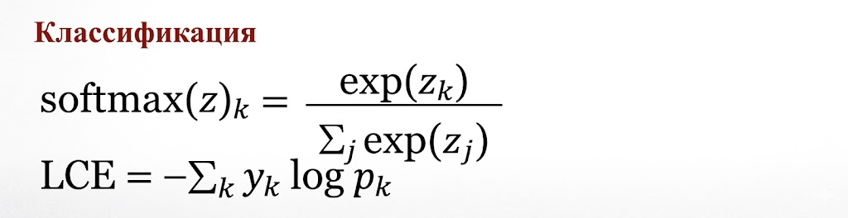



Slide 6
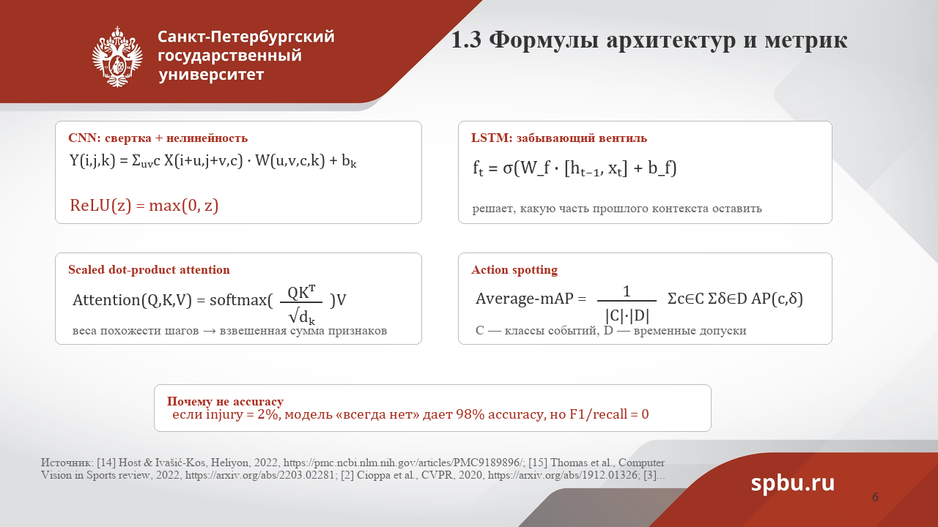
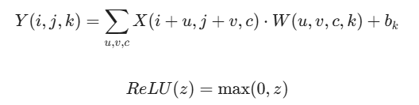



C - классы событий, D - временные допуски

Slide 7
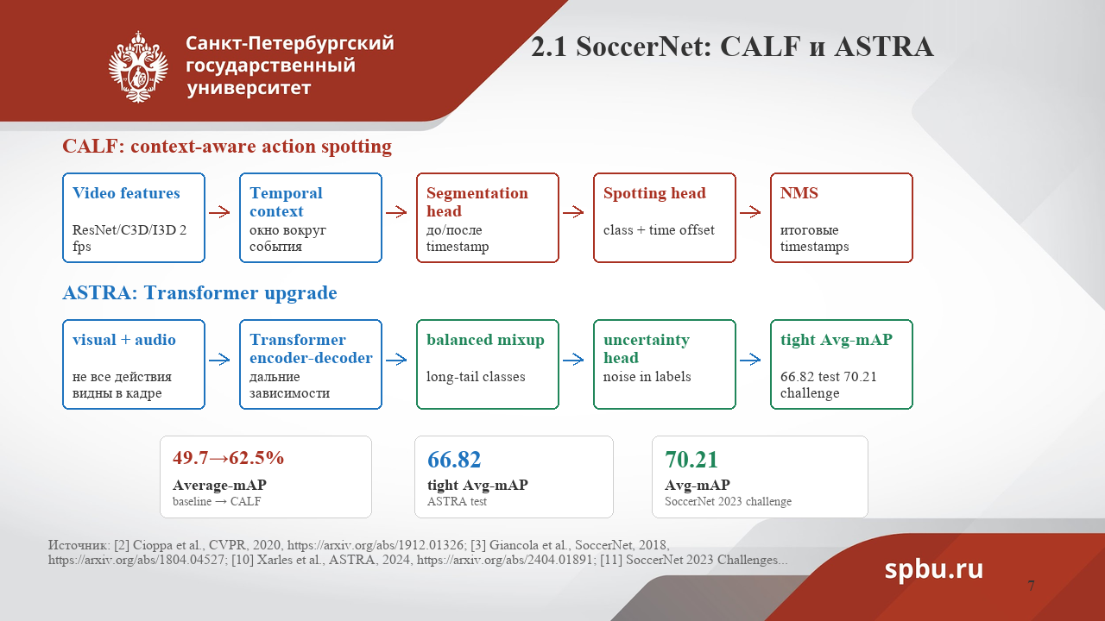

Slide 8
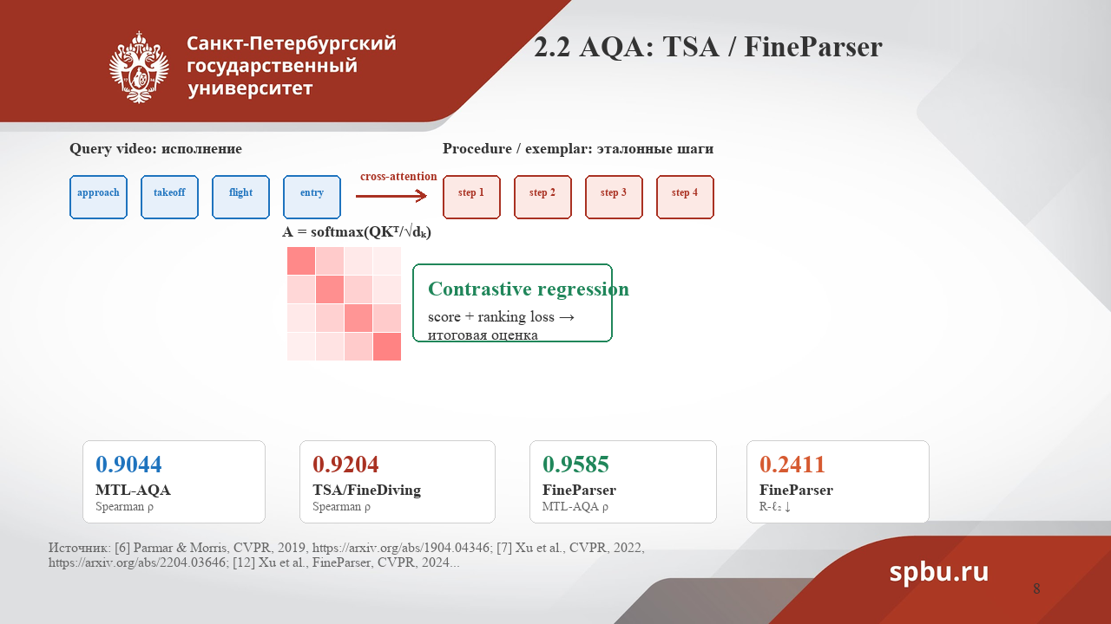

Slide 9
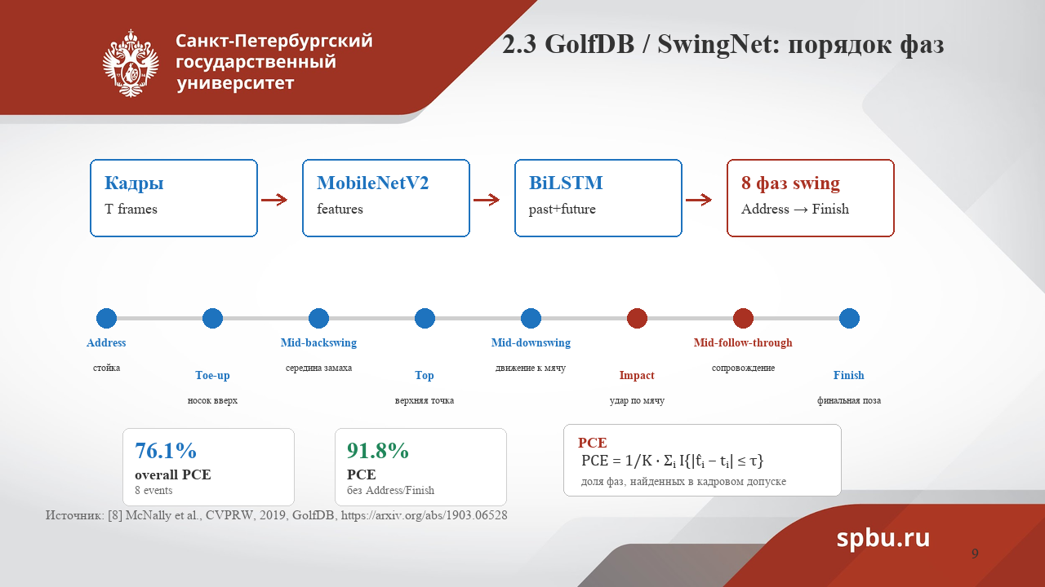

Slide 10
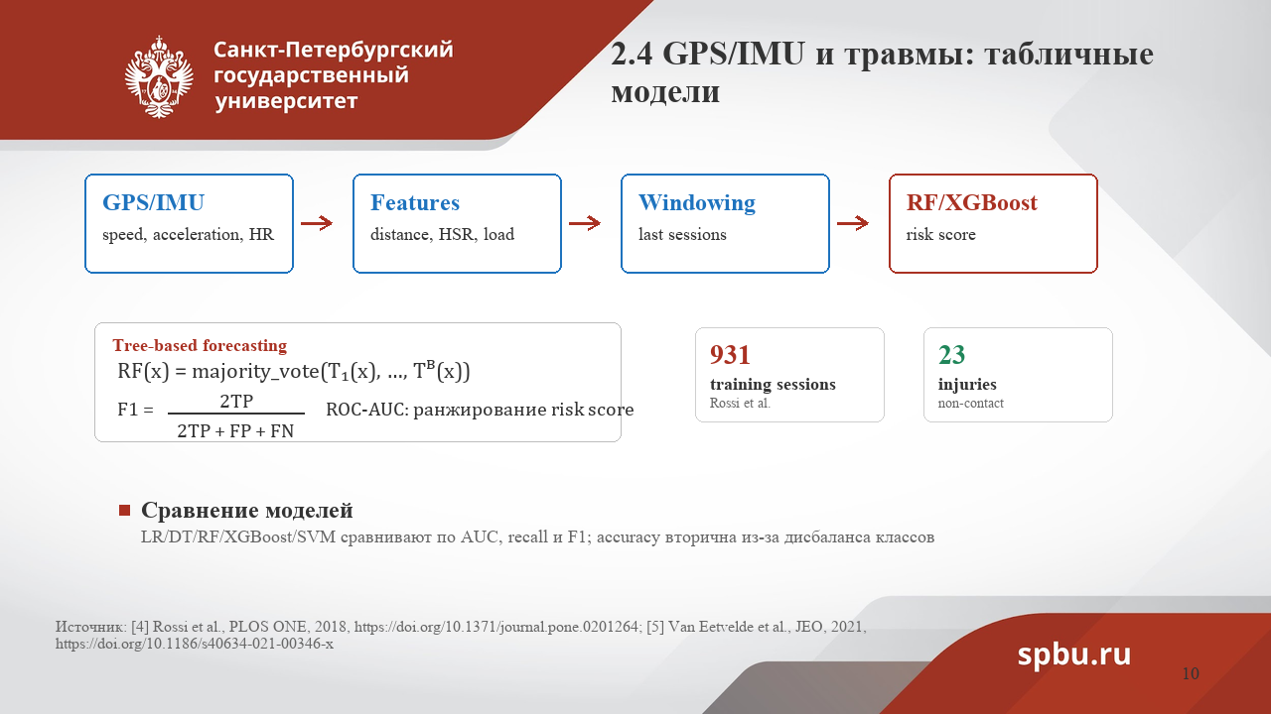

Slide 11
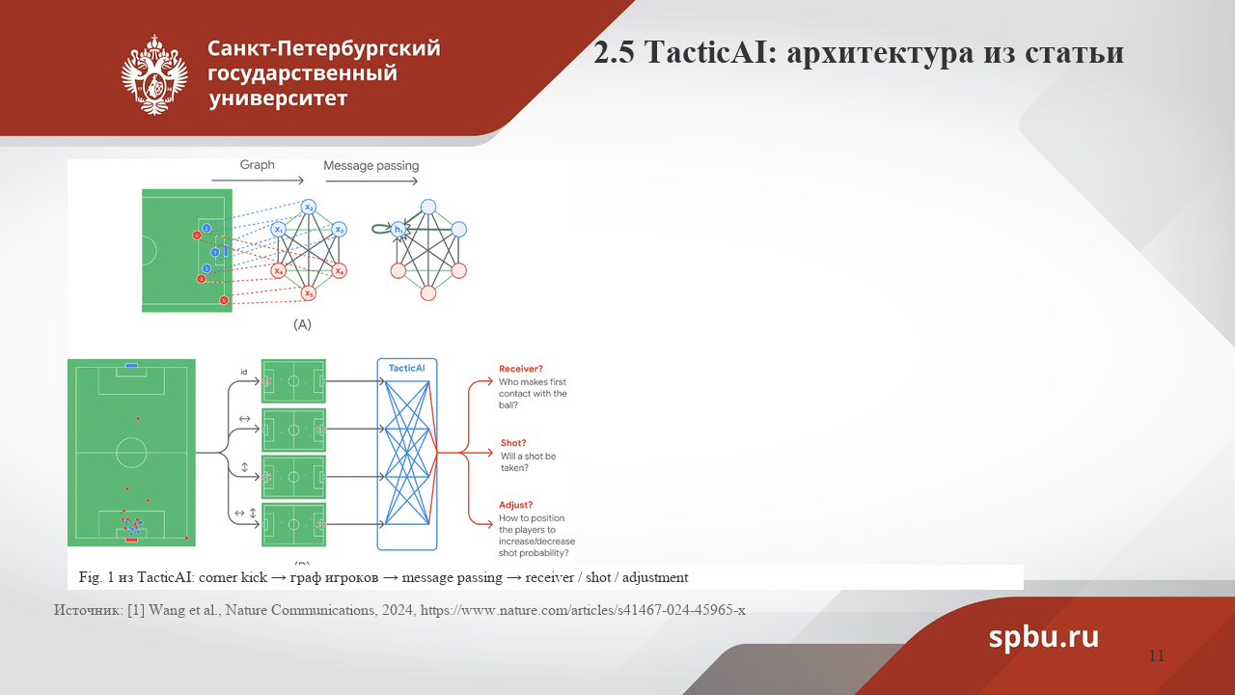

Slide 12
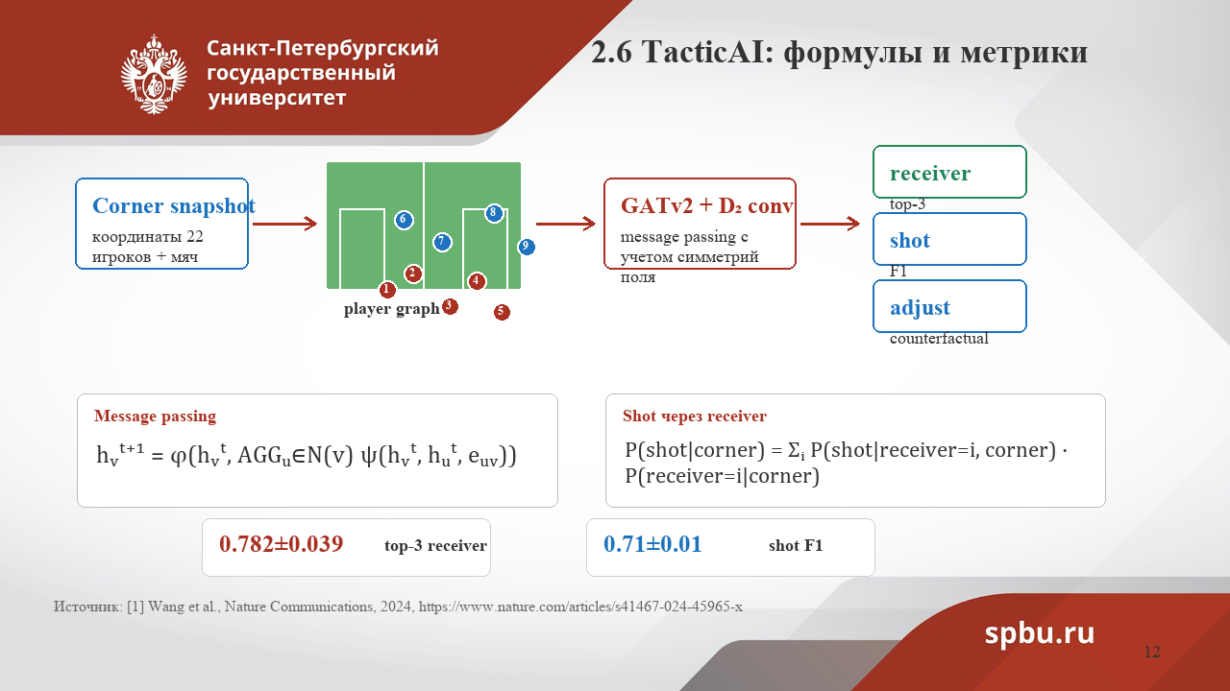


Slide 13
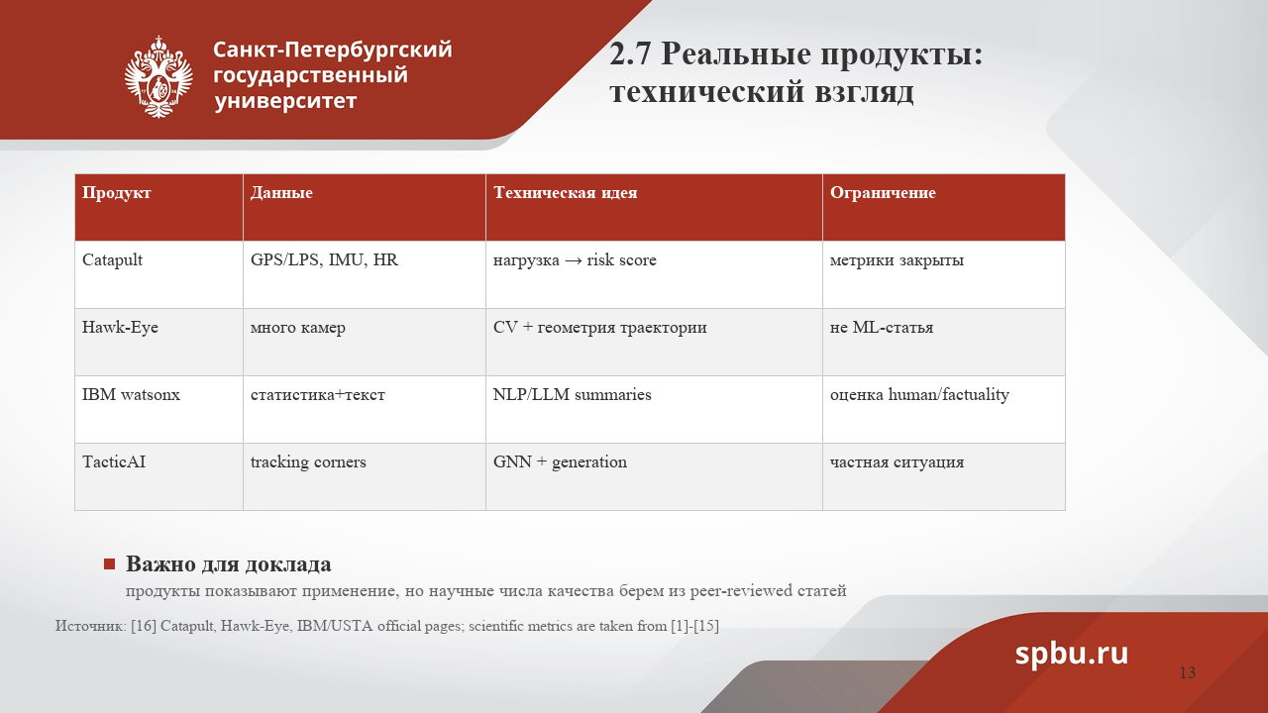

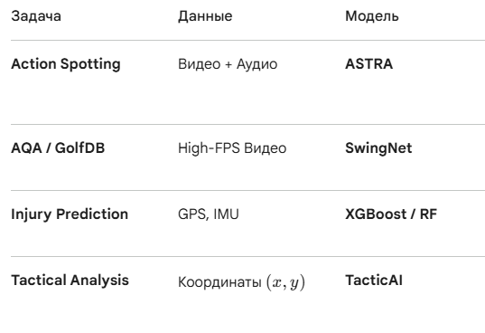
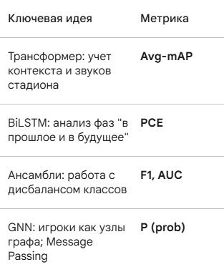

Slide 14
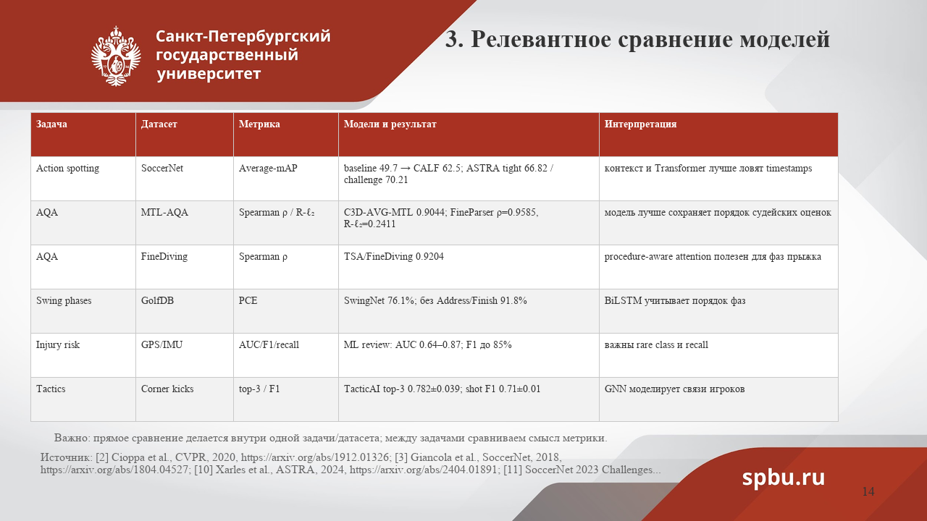

Slide 15
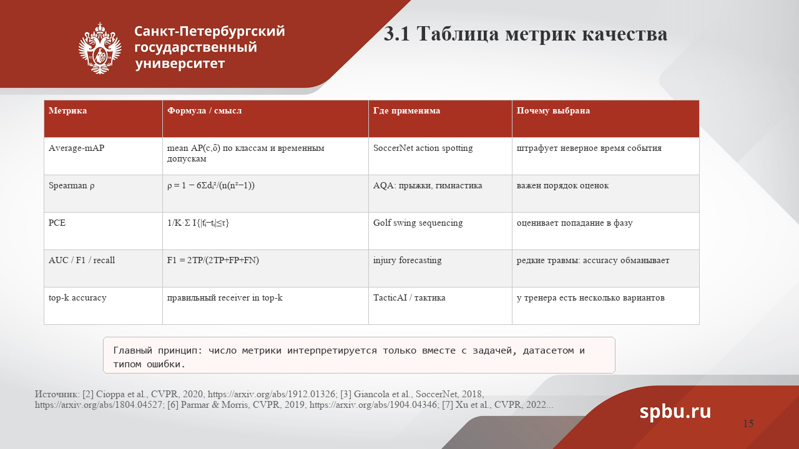

Slide 16
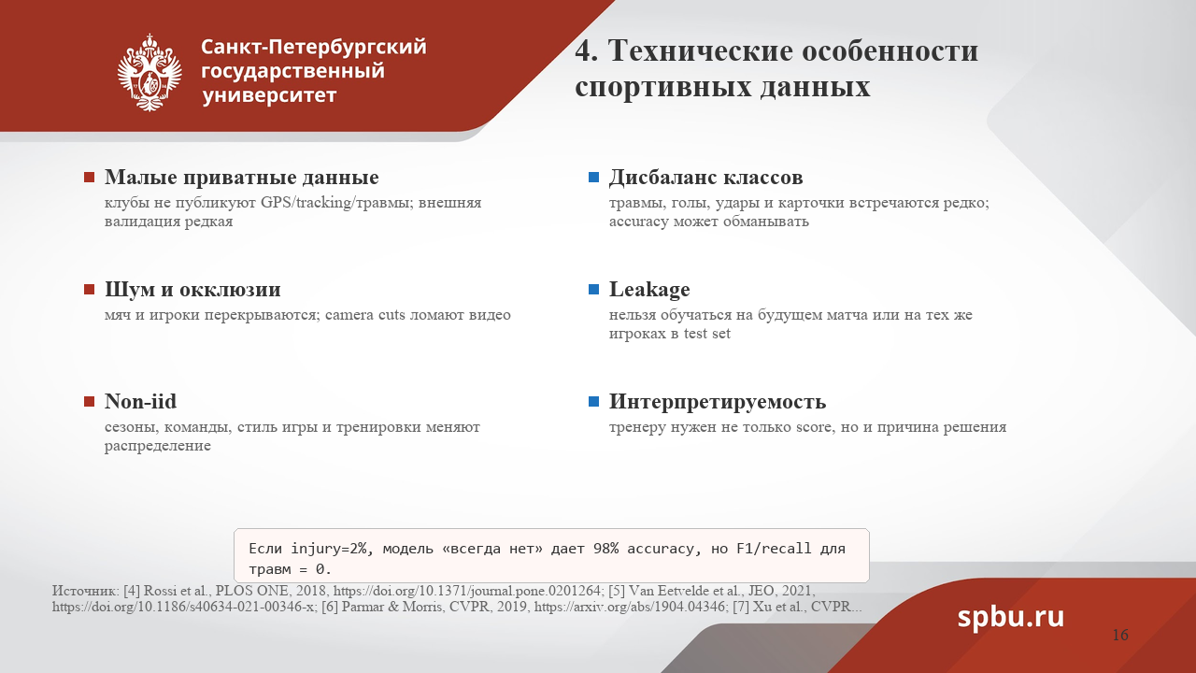

Slide 17
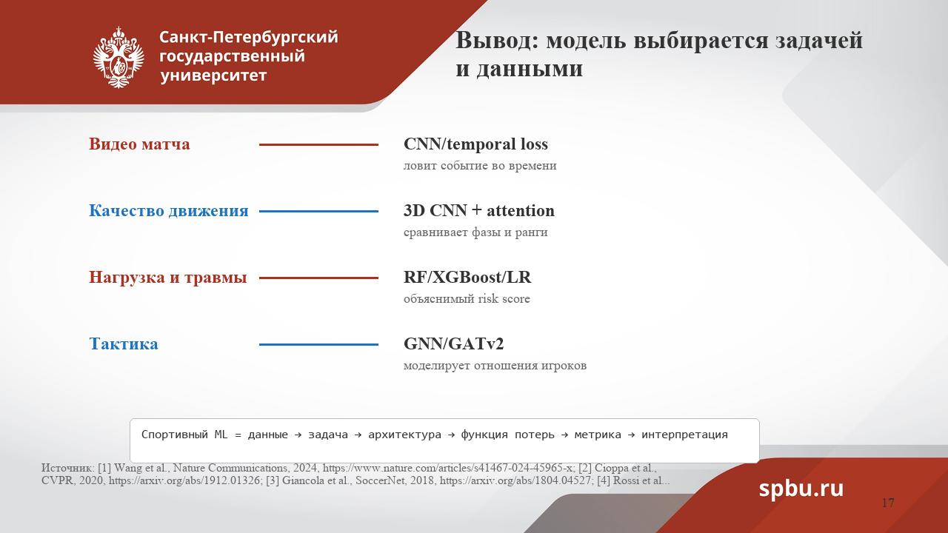

Slide 18
[1] Wang et al. TacticAI: an AI assistant for football tactics // Nature Communications. 2024.
[2] Cioppa et al. A Context-Aware Loss Function for Action Spotting in Soccer Videos // CVPR. 2020.
[3] Giancola et al. SoccerNet: A Scalable Dataset for Action Spotting in Soccer Videos // CVRP 2018.
[4] Rossi et al. Effective injury forecasting in soccer with GPS training data and ML / PLOS ONE. 2018.
[5] Van Eetvelde et al. Machine learning methods in sport injury prediction and prevention.
2021.
[6] Parmar & Morris. What and How Well You Performed? MTL-AQA // CVPR. 2019.
[7] Xu et al. FineDiving: Procedure-Aware Action Quality Assessment // CVPR. 2022.
[8] McNally et al. GolfDB: A Video Database for Golf Swing Sequencing // CVPRW. 2019.
[9] Karpathy et al. Large-scale Video Classification with CNNs // CVPR. 2014.
[10] Xarles et al. ASTRA: An Action Spotting TRAnsformer for Soccer Videos. 2024.
[11] Deliege et al. Soccer:Net 2023 Challenges Results. 2023.
[12] Xu et al. FineParser: A Fine-grained Spatio-temporal Action Parser // CVPR. 2024.
[13] Chmait & Westerbeek. Artificial Intelligence and Machine Learning in Sport Research. 2021.
[14] Host & Ivasic-Kos. Human Action Recognition in sports based on Computer Vision. 2022.
[15] Thomas et al. A Comprehensive Review of Computer Vision in Sports. 2022.
Список литературы:

